Slide 1

Intro To Vue.js and Data Binding
M3-10
Participate! The more engagement the better! You are NEVER interrupting me!

Slide 2
Objectives
Introduction to Vue
Single Page Applications (SPA)
Parts of a Vue.JS project
Components
Vue Data Binding
1-Way Data Binding
Arrays with v-for
Binding DOM Element Attributes with v-bind
Computed Properties
Conditional Elements using v-if
2-Way Data Binding with v-model
Conditional Attributes with v-bind

Slide 3
What is Vue.js
Vue.js is a component-based, single page application Javascript framework. (same as Angular and React).
Components are loaded into a single page to build the overall website design using the virtual DOM.
We are using Vue version 3
Documentation: is at https://vuejs.org/

Slide 4
Why Vue.js
Vue.js is one of the most popular JS frameworks.
React
Angular
Vue.js
Ember
Backbone.js
Little less learning curve than React and Angular (but same concepts)
Extremely fast and lightweight

Slide 5
Single Page Application (SPA)
Know what a SPA is and some pros and cons
Serves a single HTML page and all other “pages” in the site are generated using DOM manipulation of the original HTML with new data retrieved from web API using JavaScript.
Pros
Better user experience
Server-side require less resources
the Server uses web services to provide data, so it is further decoupled from the view
Allows separation of focus for developers: frontend developer can focus fully on the frontend and backend developers fully on the backend
Good choice for web based applications. Not so much for simple, informational /content sites

Slide 6
Single Page Applications (SPA) Continued
Cons:
Slower upfront load time as browser has to build the page, fetch data, render components, etc
Sites that rely heavily on articles/content(blogs) are not indexed well, if at all.
Requires more backend development, so may not be appropriate for a simple site.
SPA needs to be more aware of Accessibility concerns.
Since we are getting rid of the browsers default navigation (Back button, etc) SPA must handle these events.

Slide 7
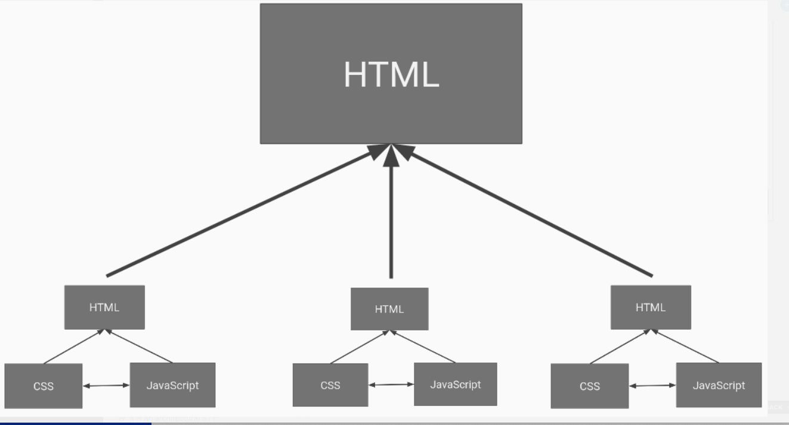
component

Slide 8
Anatomy of a Vue.js Component
Output (HTML) | Functionality (JS) | Style (CSS)
<template> <div class=”namebox”> <h1>{{ user.name }}</h1> </div> </template> | <script> export default { name: ‘ComponentName-USer’, data() { return { user: { name: ‘Joe’ } } } } </script> | <style scoped> h1 { font-size: 12px; } </style>

Slide 9
STOP HERE

Slide 10


NPM - Node Package Manager
NPM is the world's largest software registry. It is used by software developers all over the world to share and borrow packages.
It has a command line tool that we will use to manage our dependencies and to transpile or compile our code into an older version of javascript that all browsers can support.

Slide 11
1-Way Data Binding
<template>
<div class="main">
<p class="description">{{ description }}</p>
</div>
</template>
<script>
export default {
...
data() {
return {
description: 'This is a description'
}
}
}
</script>
Uses the {{ variable }} syntax
Like a placeholder in HTML that “binds” to the variable in the data. Binding means that they stay in sync.
If the variable changes the value on the page is “automatically” updated - this is called reactivity.

Slide 12
data() function
<template>
<div class="main">
<p class="description">{{ description }}</p>
</div>
</template>
<script>
export default {
...
data() {
return {
description: 'This is a description'
}
}
}
</script>
data() is where the memory of each component lives. This is where you would store data (hence the name), and any other variables you want to track.
This data is private, and only for the component itself to use (Allows us the ability to put multiple components of the same type of a page with different data values)

Slide 13
Computed Properties
<template>
<div class="main">
<p class="description">{{ averageRating }}</p>
</div>
</template>
<script>
export default {
...
data() { . . . },
computed: {
averageRating(vm) {
let sum = vm.reviews.reduce( (currentSum, review) => {
return currentSum + review.rating;
}, 0);
return sum / vm.reviews.length;
}
}
</script>
Allows one way data binding to a calculated value
Similar to a derived property in Java
If the value of the computed property changes then the bound text is updated on the page
The vm (View Model) object is automatically passed as an argument to computed properties. The vm object contains the values in data()

Slide 14
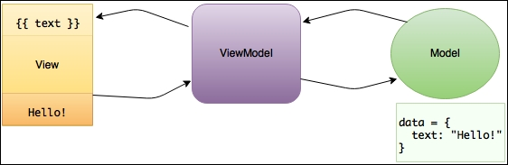
What is Vue’s View Model?
View Model is an object layer that acts as a go-between the View (your HTML template) and the Model (the data/logic). It helps facilitate data binding and reactivity.

Slide 15
Methods
We can also add functions to our component. Added in the methods: {} section.
Methods are not passed the vm (ViewModel) and are NOT REACTIVE - meaning they are not updated when values change, we must call them when there is an update or use them in a computed property and pass them the data to make them reactive - which will the reactive computed property to call the method again when the data is changed.
Methods can use the this keyword. this refers to this component and can be used to access the data in the view model.

Slide 16
Conditional Elements
Added as an attribute to the HTML element you want to be conditional
v-if=”<boolean condition>”
if FALSE does not add or removes the element from the DOM
v-show=”<boolean condition>”
if FALSE adds the element to the DOM, but hides it
<p v-if="showDescription" class="description">{{ description }}</p>
<p v-show="showDescription" class="description">{{ description }}</p>
https://www.digitalocean.com/community/tutorials/vuejs-conditional-directives

Slide 17
Rendering Arrays
Add v-for to any HTML element and that element will be created once for each loop.
Requires an identifier for each row called the key. If a unique identifier is present in the object, like an id, then that should be used for the key. If not then another value can be used.
v-for=”variable in arrayOrObject” v-bind:key=”id”
variable: a variable name to hold each item in the array arrayOrObject: The array or object to loop over id: the key to use

Slide 18
Arrays Continued
Array
instructors = [ { id: 1, name: Andrew }, { id: 2, name: Rachelle } ]
v-for
<div v-for=”instructor in instructors” v-bind:key=”instructor.id” > {{ instructor.name }} </div>
Generated HTML
<div> Andrew </div> <div> Rachelle </div>

Slide 19
Binding to DOM element Attributes
v-bind allows for data in the view model to be bound to attributes of elements in the DOM.
Any attribute (src, title, class, etc.) can be bound to data or a simple conditional statement using v-bind
<img src="../assets/star.png" v-bind:title="review.rating + ' Star Review'" />

Slide 20
Conditional with v-bind
Simple conditionals can be used with v-bind. For example, binding different CSS classes depending on a condition.
Conditionals in a v-bind are blocked by a single { } instead of {{ }} like is used in variable binding. The value can either be a string in single quotes or a variable. The value and the condition are separated by a colon ( : ). When the condition is TRUE the value is used, when it is false no value is used. It is possible to do more complex bindings with else like conditions.
Syntax: v-bind:attribute=”{ ‘value’ : boolean condition}”
<h4 v-bind:class="{'verifiedReviewer' : review.verifiedReview}">{{ review.reviewer }}</h4>
Output when review.verifiedReview is TRUE: <h4 class=”verifiedReviewer”>...</h4> <img src=””>
Output when review.verifiedReview is FALSE: <h4 class=””>...</h4>

Slide 21
2-Way Model Binding
Form elements, which can be changed by a user (text fields, radio buttons, select boxes, etc.), can be bound using 2-way data binding using the v-model attribute.
2-way data binding keeps the data and the user input in sync. So that when the form element is changed by the user the data is reactively updated and if the data is changed the form element is reactively updated.
Some Vue attributes, like v-model can accept modifiers. For example, v-model.trim modifies the data by removing leading and trailing whitespace similar to trim() in Java.
HTML
<input
type="text"
id="name"
v-model.trim="contact.name"
/>
Data
contact: {
name: '',
email: '',
emailType: ''
}

